Slide 1
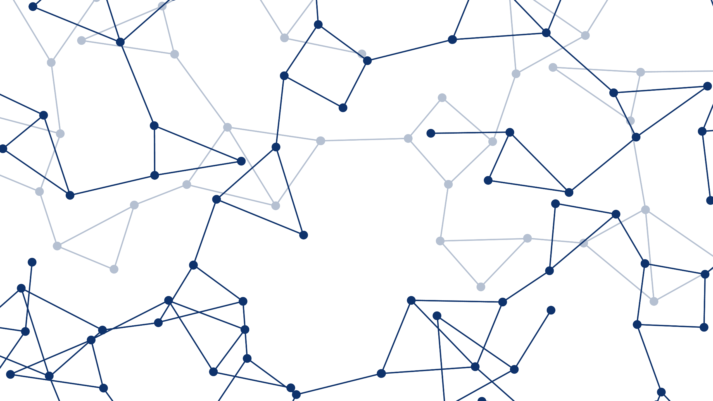
ATOMS-02: UAS Traffic Management I
Using Genetic Algorithm to
Modify Scheduled Flights
to Track Regular Traffic
Leonardo Piñero
17 June 2019

Slide 2
➤ BACKGROUND ➤ METHODOLOGY ➤ RESULTS
Problem Statement
Develop a methodology to alter existing flight routes
NORTH
TARGET OBJECT PATH
UAV SCHEDULED PATH
(UNALTERED)
WEST
EAST
SOUTH

Slide 3
➤ BACKGROUND ➤ METHODOLOGY ➤ RESULTS
Problem Statement
Develop a methodology to alter existing flight routes that balances the conflicting objectives of preserving the original route and increasing coverage of detected target motion
NORTH
TARGET OBJECT PATH
UAV SCHEDULED PATH
(ALTERED)
WEST
EAST
SOUTH

Slide 4
➤ BACKGROUND ➤ METHODOLOGY ➤ RESULTS
Motivation
Existing Solutions to pure SAT take a Probabilistic Approach
The methodology presented intends to contribute a novel heuristic solution based on regular geometry for predictable, but unknown, targets

Slide 5
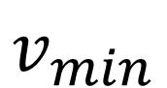
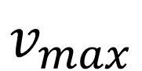
➤ BACKGROUND ➤ METHODOLOGY ➤ RESULTS
Motivation
Existing Solutions to pure SAT take a Probabilistic Approach
The methodology presented intends to contribute a novel heuristic solution based on regular geometry for predictable, but unknown, targets
$$v_{max}$$
$$v_{min}$$
TARGET’S POSSIBLE VELOCITIES FOR CURRENT TIME FRAME
POSSIBLE LOCATIONS AT NEXT TIME FRAME
PROBABILITY MAP INFORMS TRACKING

Slide 6
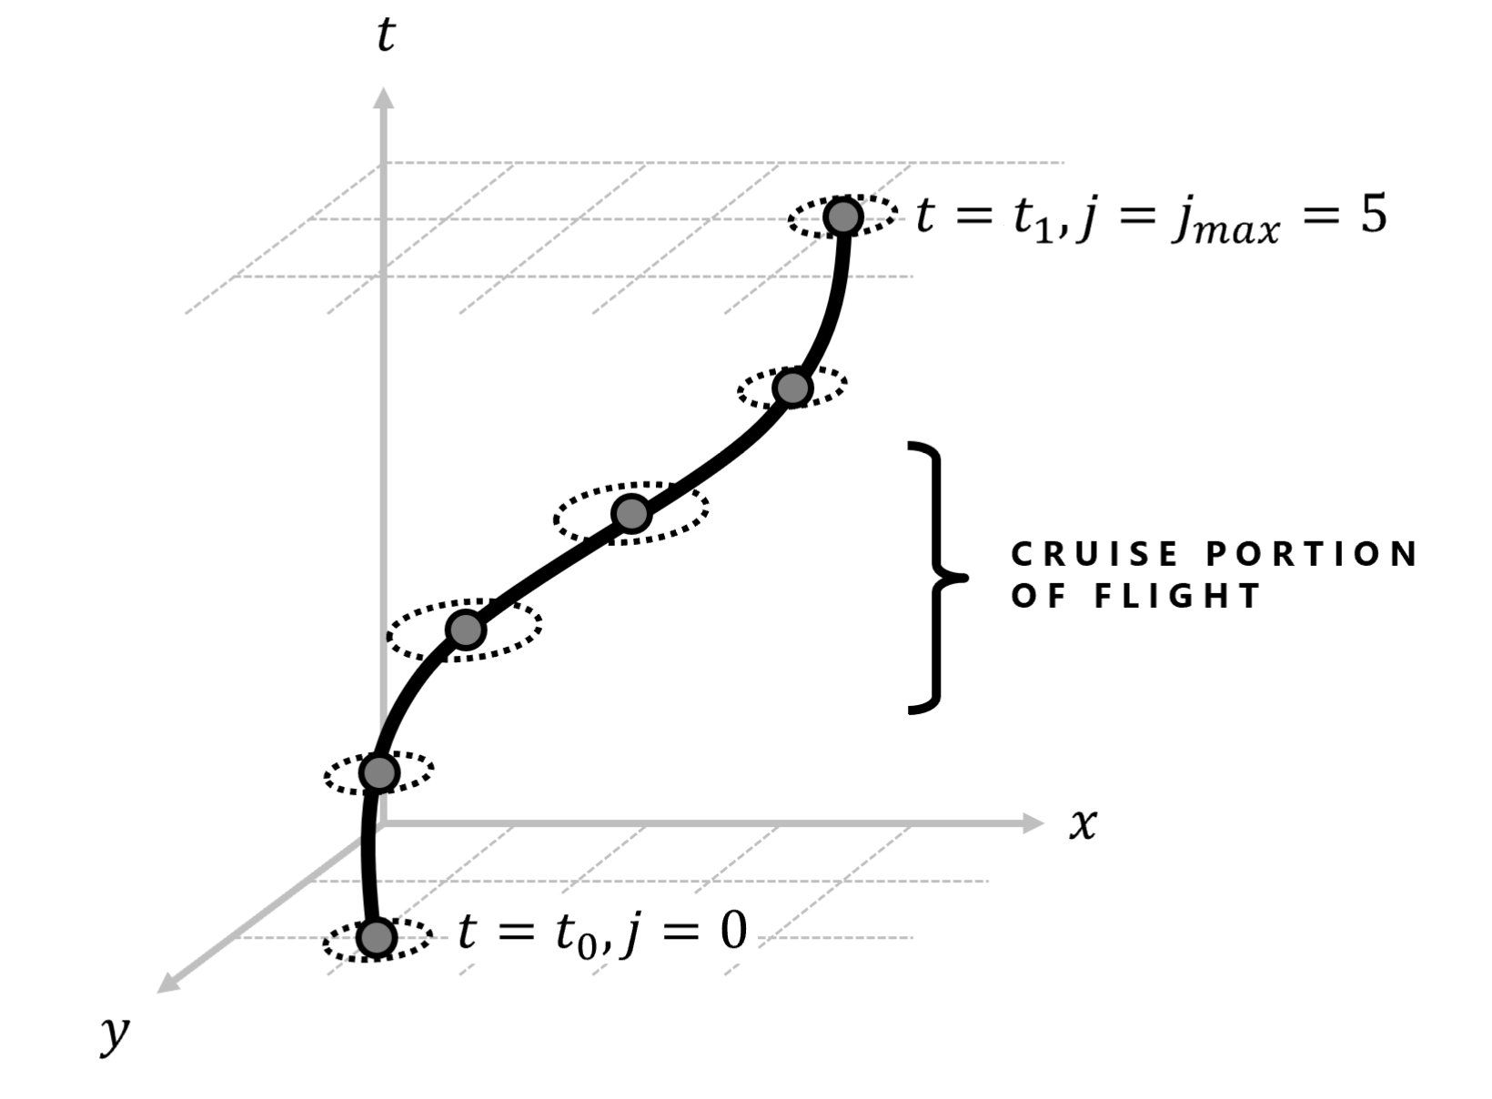
➤ BACKGROUND ➤ METHODOLOGY ➤ RESULTS
Motivation
Existing Solutions to pure SAT take a Probabilistic Approach
The methodology presented intends to contribute a novel heuristic solution based on regular geometry for predictable, but unknown, targets
Geometric Approach to Search-and-Track Problem
The genetic algorithm is guided by imagining regular target paths as 3-dimensional line segments to mold into

Slide 7
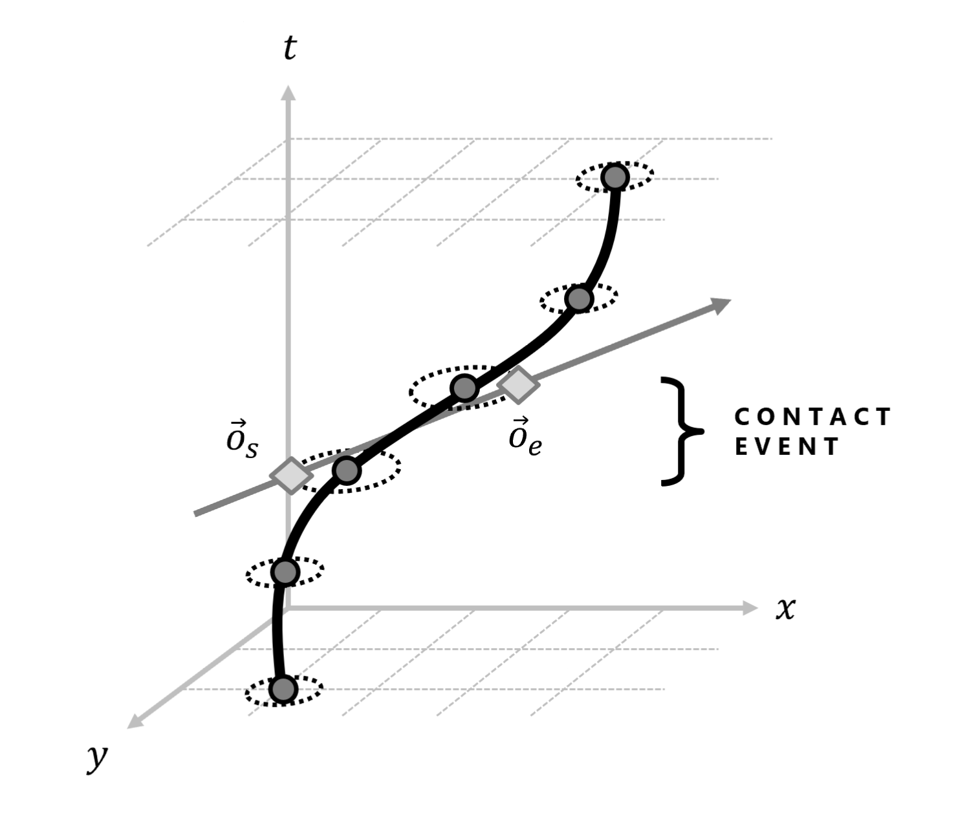
➤ BACKGROUND ➤ METHODOLOGY ➤ RESULTS
Motivation
Existing Solutions to pure SAT take a Probabilistic Approach
The methodology presented intends to contribute a novel heuristic solution based on regular geometry for predictable, but unknown, targets
Geometric Approach to Search-and-Track Problem
The genetic algorithm is guided by imagining regular target paths as 3-dimensional line segments to mold into

Slide 8
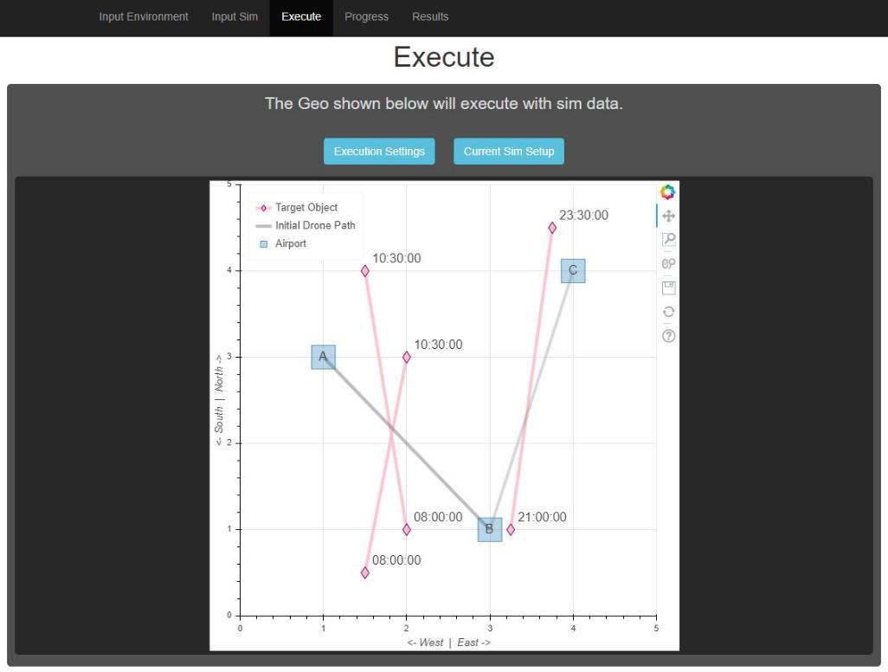
➤ BACKGROUND ➤ METHODOLOGY ➤ RESULTS
Motivation
Existing Solutions to pure SAT take a Probabilistic Approach
The methodology presented intends to contribute a novel heuristic solution based on regular geometry for predictable, but unknown, targets
Geometric Approach to Search-and-Track Problem
The genetic algorithm is guided by imagining regular target paths as 3-dimensional line segments to mold into
Create Open-Source Guidance Software for Managing UAV Fleets
The user interface developed allows the user to utilize the genetic algorithm to increase tracking performance for a fleet

Slide 9
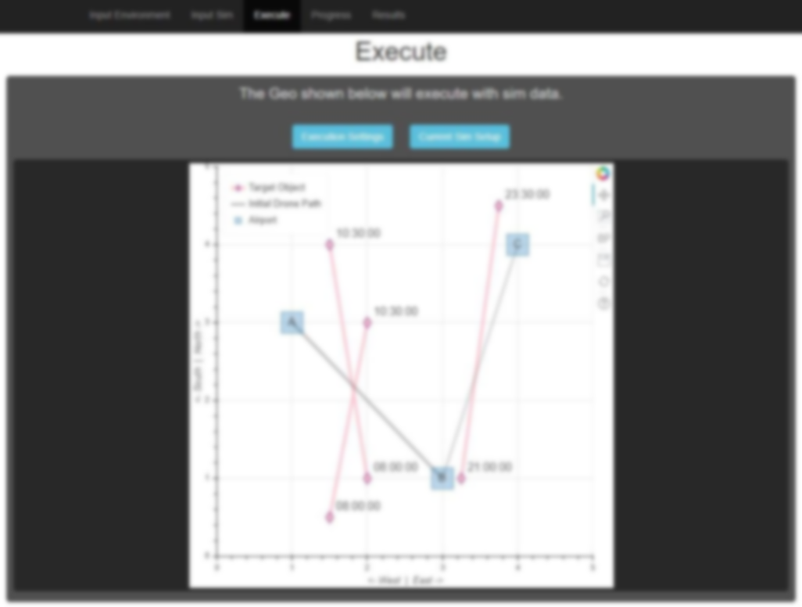
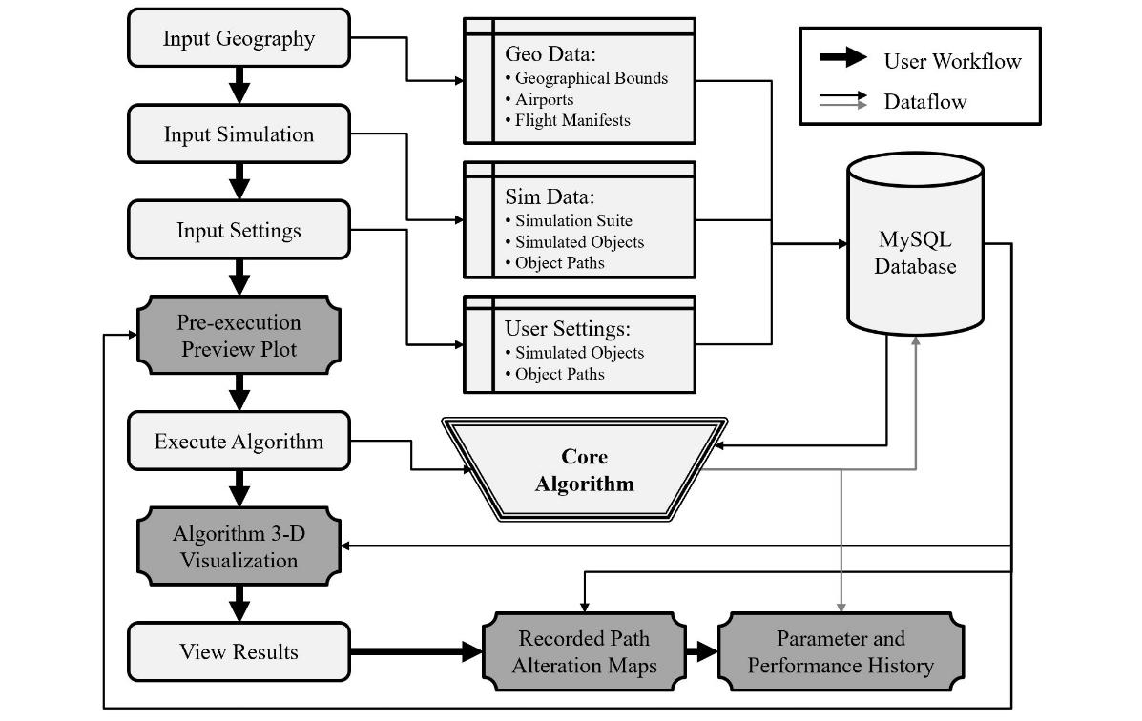
➤ BACKGROUND ➤ METHODOLOGY ➤ RESULTS
Motivation
Existing Solutions to pure SAT take a Probabilistic Approach
The methodology presented intends to contribute a novel heuristic solution based on regular geometry for predictable, but unknown, targets
Geometric Approach to Search-and-Track Problem
The genetic algorithm is guided by imagining regular target paths as 3-dimensional line segments to mold into
Create Open-Source Guidance Software for Managing UAV Fleets
The user interface developed allows the user to utilize the genetic algorithm to increase tracking performance for a fleet

Slide 10

➤ BACKGROUND ➤ METHODOLOGY ➤ RESULTS
Applications
Google Maps Traffic Validation
Existing traffic is estimated by Android users’ anonymized location
UAV routes which give visual confirmation would help determine the reliability of current estimates, especially in areas with low Android usage

Slide 11


➤ BACKGROUND ➤ METHODOLOGY ➤ RESULTS
Applications
Google Maps Traffic Validation
Existing traffic is estimated by Android users’ anonymized location
UAV routes which give visual confirmation would help determine the reliability of current estimates, especially in areas with low Android usage
Ecological Observation
The spatial and temporal resolution of satellite imagery is unreliable for observing smaller fauna, such as water fowl
UAV routes can track the regular movements of fauna throughout the day

Slide 12





➤ BACKGROUND ➤ METHODOLOGY ➤ RESULTS
Applications
Google Maps Traffic Validation
Existing traffic is estimated by Android users’ anonymized location
UAV routes which give visual confirmation would help determine the reliability of current estimates, especially in areas with low Android usage
Ecological Observation
The spatial and temporal resolution of satellite imagery is unreliable for observing smaller fauna, such as water fowl
UAV routes can track the regular movements of fauna throughout the day
Atmospheric Survey
Patterns in air pollution movement may be observed
Satellite imagery has been used, but UAV fleets can provide higher temporal resolution for faster-moving clouds

Slide 13
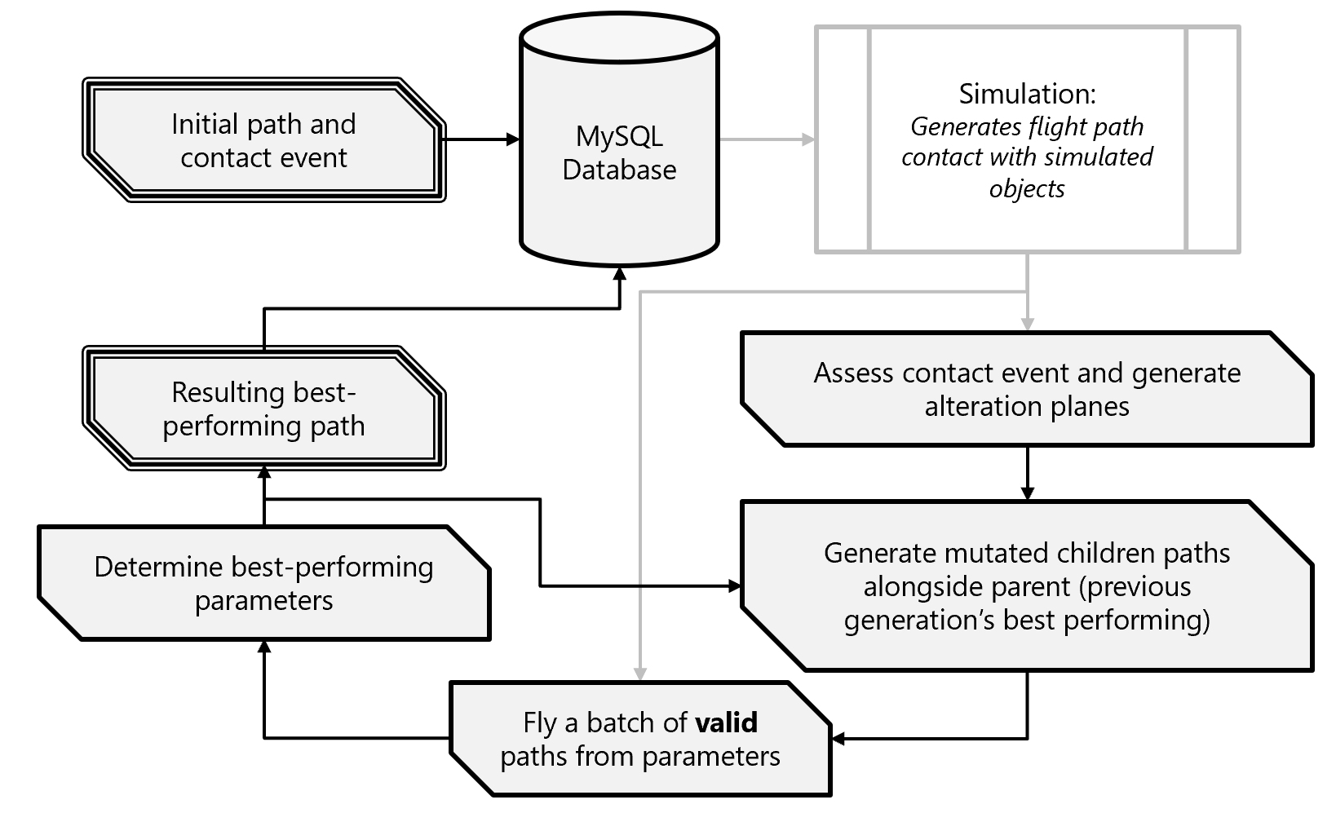
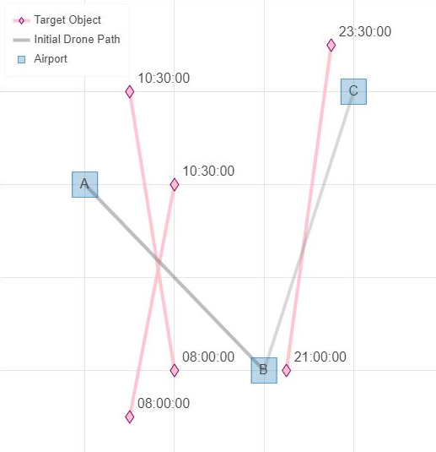
➤ BACKGROUND ➤ METHODOLOGY ➤ RESULTS
Methodology
Main loop of algorithm takes feedback from simulation
NORTH
W
E
S

Slide 14
➤ BACKGROUND ➤ METHODOLOGY ➤ RESULTS
Methodology
Every instance of target contact initializes algorithm

Slide 15
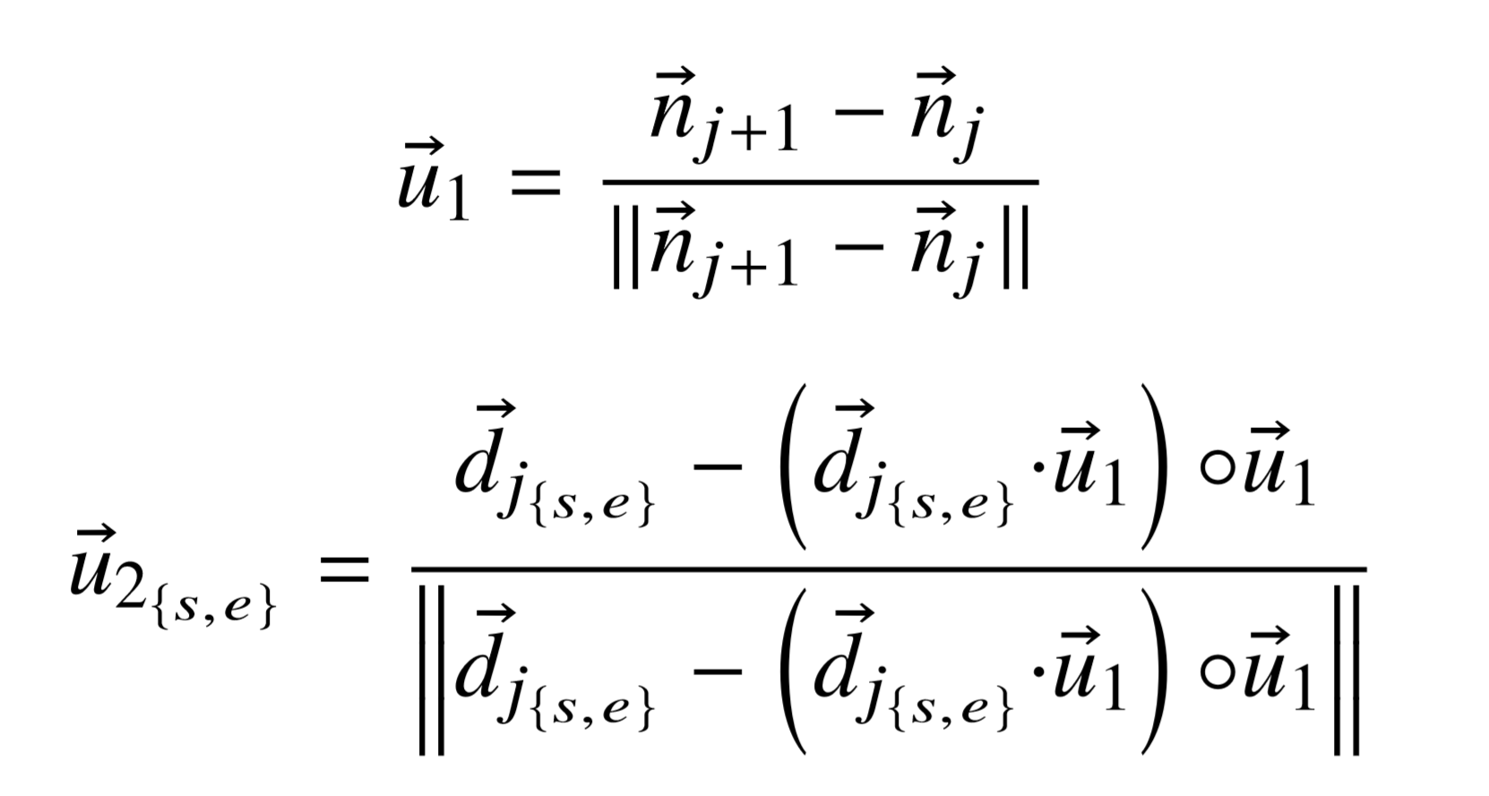
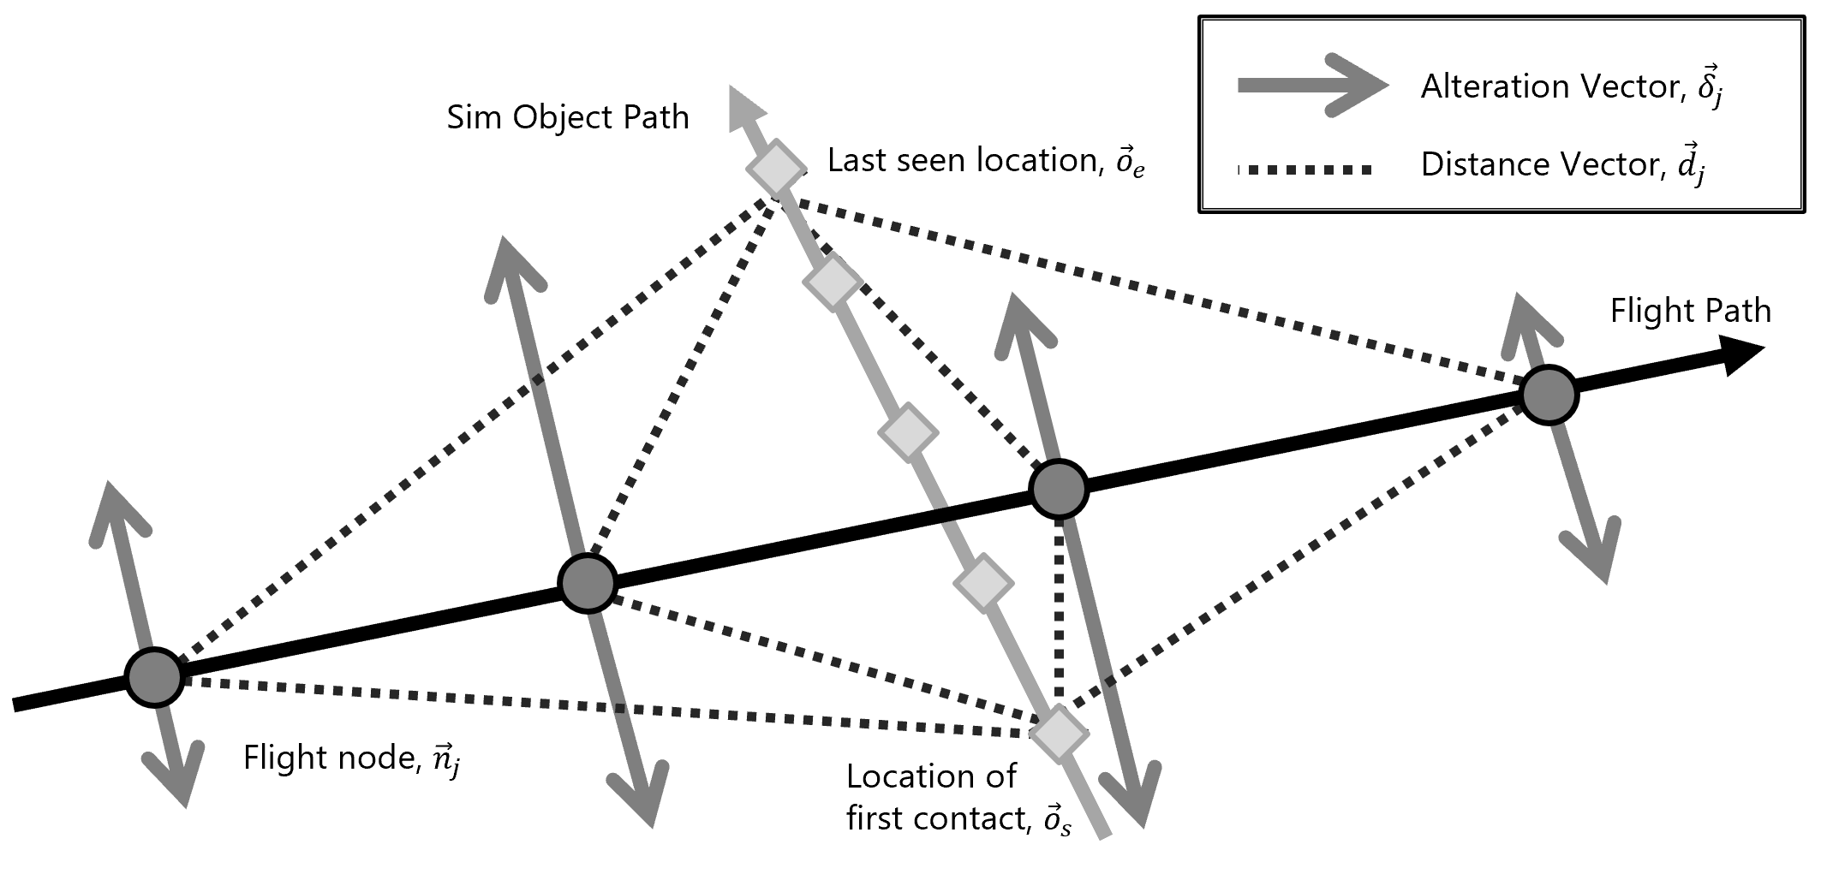
➤ BACKGROUND ➤ METHODOLOGY ➤ RESULTS
Methodology
Generate alteration vectors along common plane in the 3-D path space
BASIS VECTORS OF COMMON PLANE

Slide 16
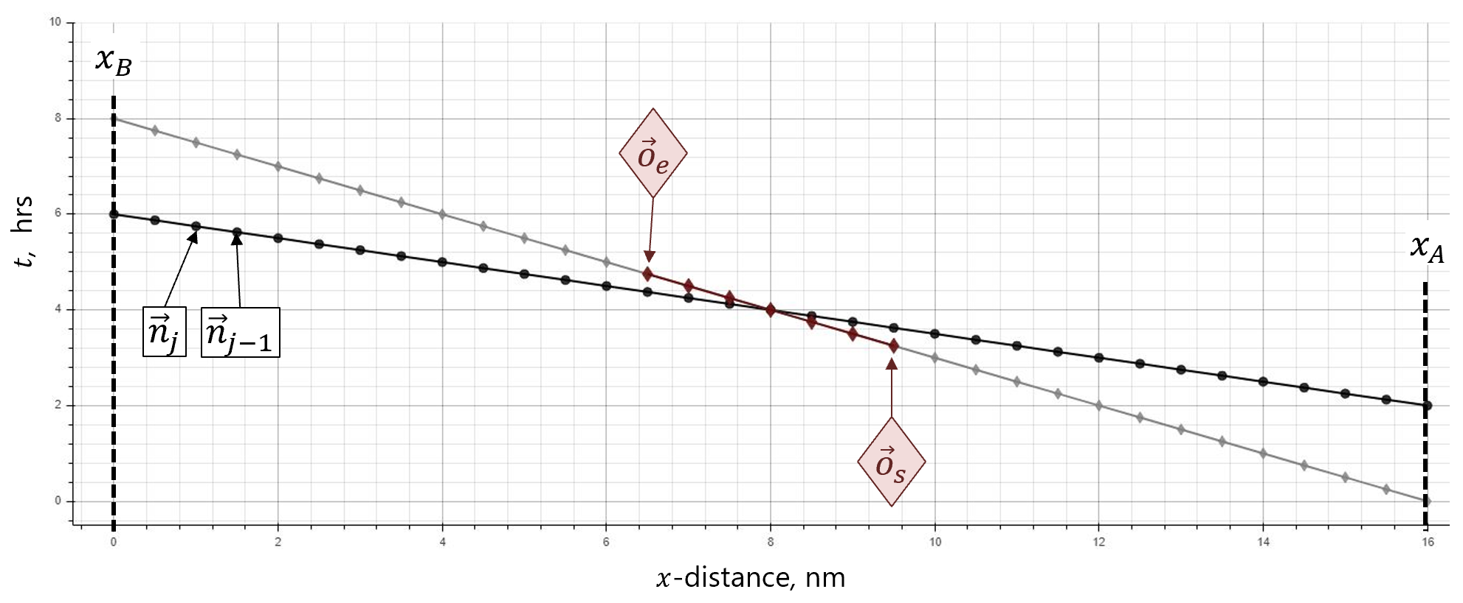
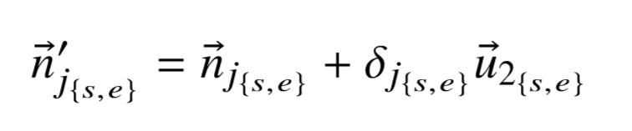
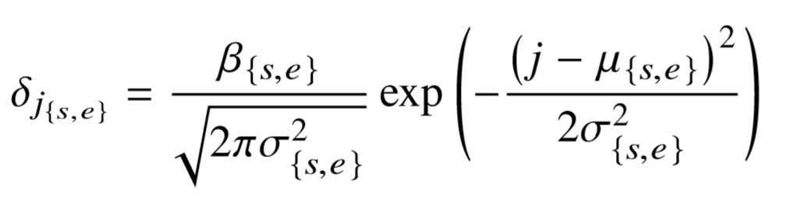
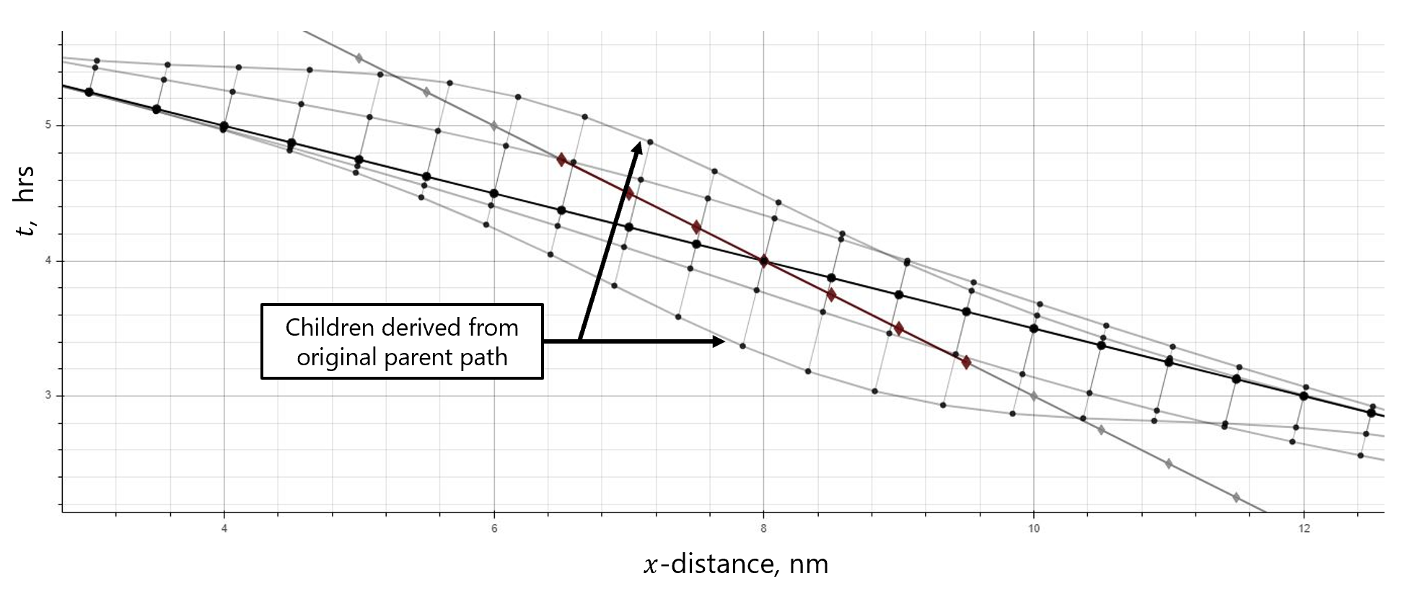
➤ BACKGROUND ➤ METHODOLOGY ➤ RESULTS
Methodology
Children are generated by evolved parameters: ${\left({\left\{β, σ, μ\right\}}_{{\left\{s, e\right\}}_{i}}\right)}_{b}$

Slide 17
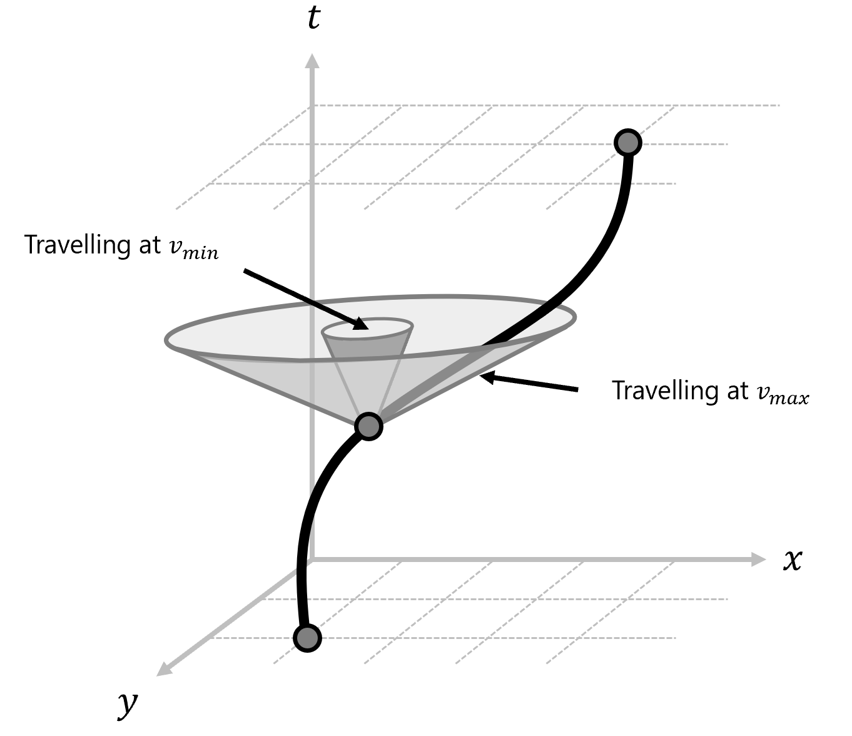
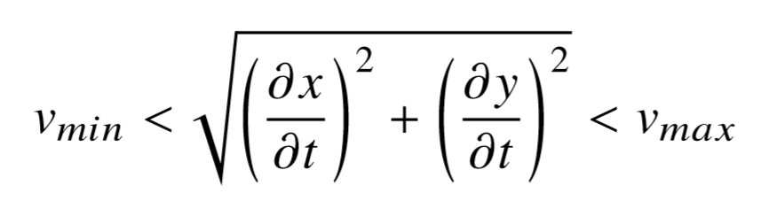
➤ BACKGROUND ➤ METHODOLOGY ➤ RESULTS
Methodology
Some children are impossible to fly, so they are filtered from the batch (hyperparameters will adjust aggressiveness to ensure valid children are created)

Slide 18
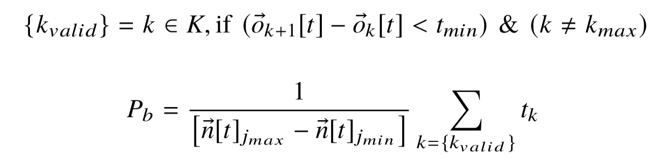
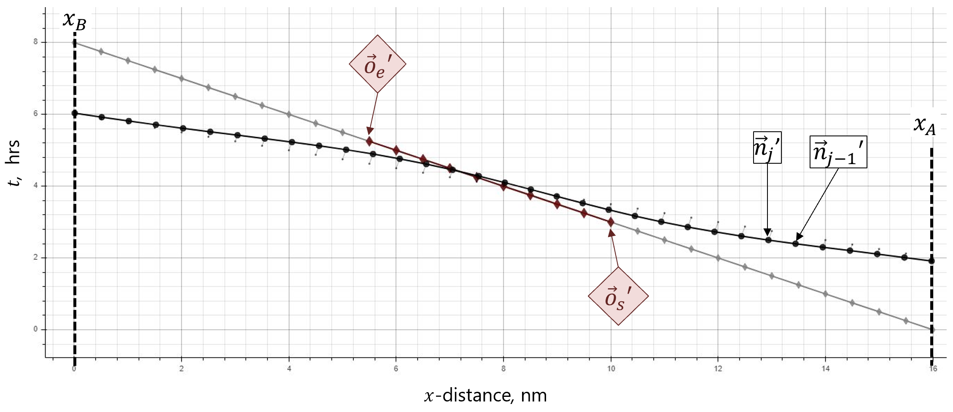
➤ BACKGROUND ➤ METHODOLOGY ➤ RESULTS
Methodology
Parameters ${\left({\left\{β, σ, μ\right\}}_{{\left\{s, e\right\}}_{i}}\right)}_{b_{P_{max}}}$which led to the best-performing child are kept for next generation
Performance is determined by the percentage of the ﬂight time where the drone is in contact with target object

Slide 19
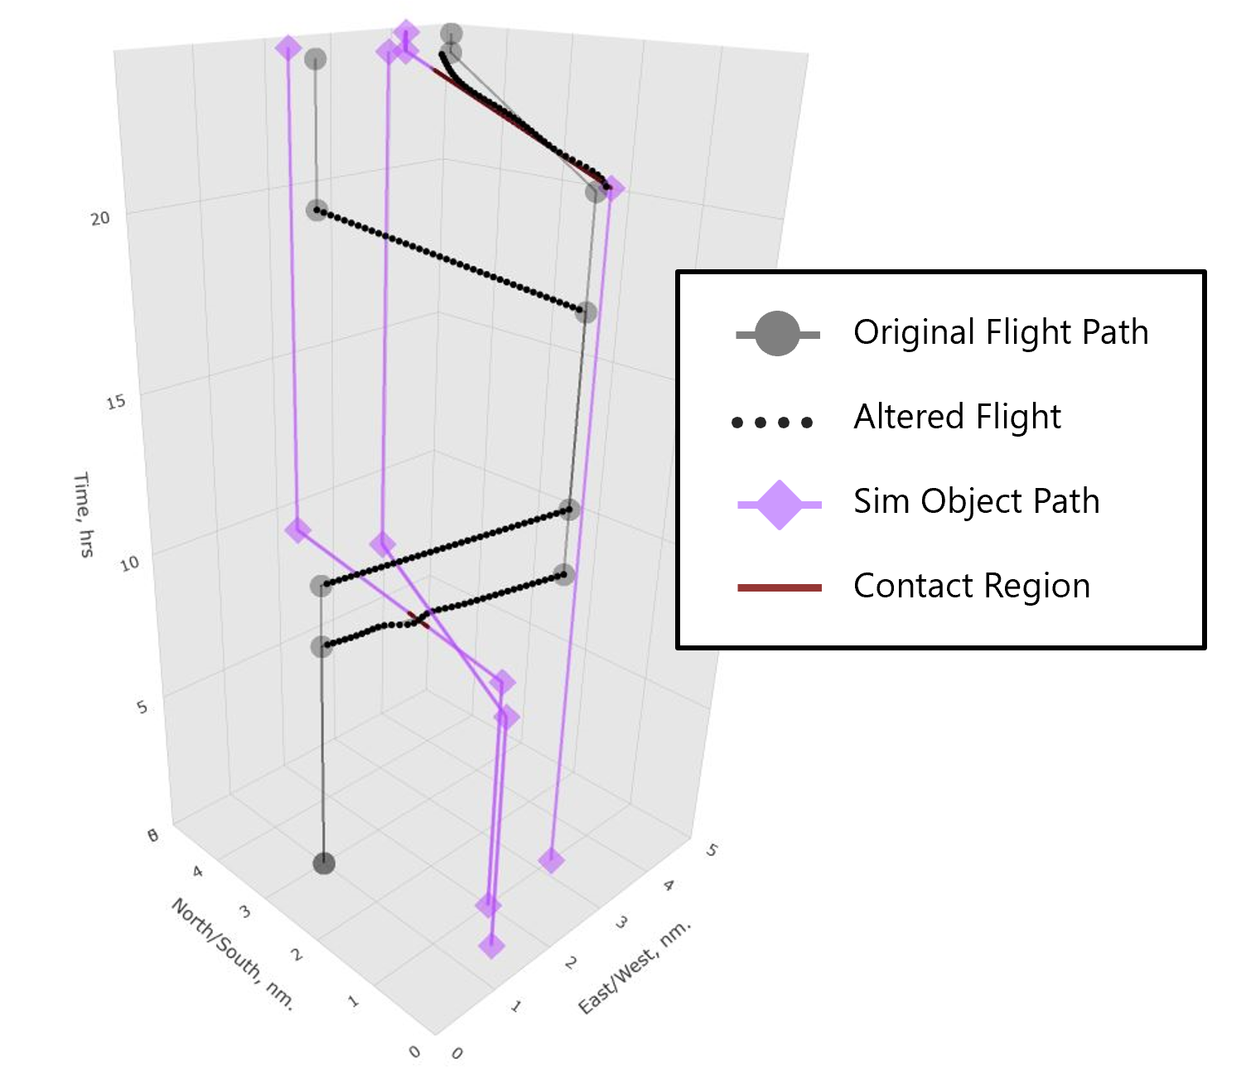
➤ BACKGROUND ➤ METHODOLOGY ➤ RESULTS
Results
Initial conditions to end result of simulation:
NORTH
W
E
S

Slide 20
➤ BACKGROUND ➤ METHODOLOGY ➤ RESULTS
Results
Initial conditions to end result of simulation:
NORTH
W
E
S

Slide 21
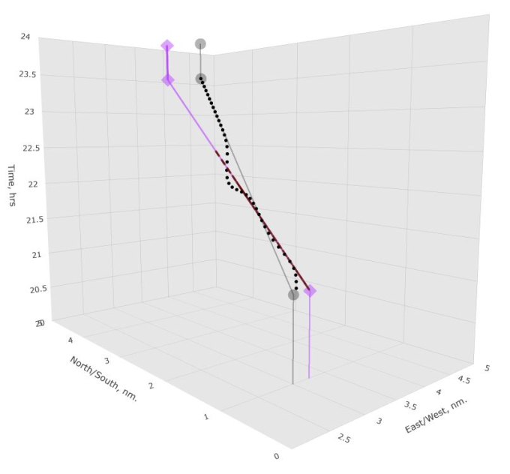
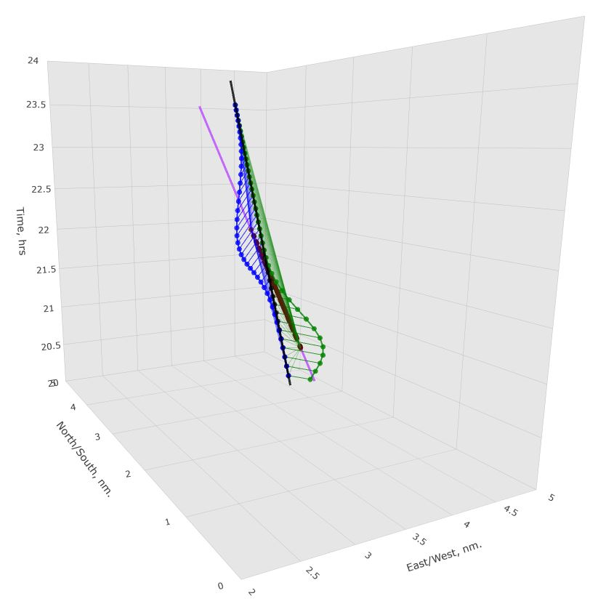
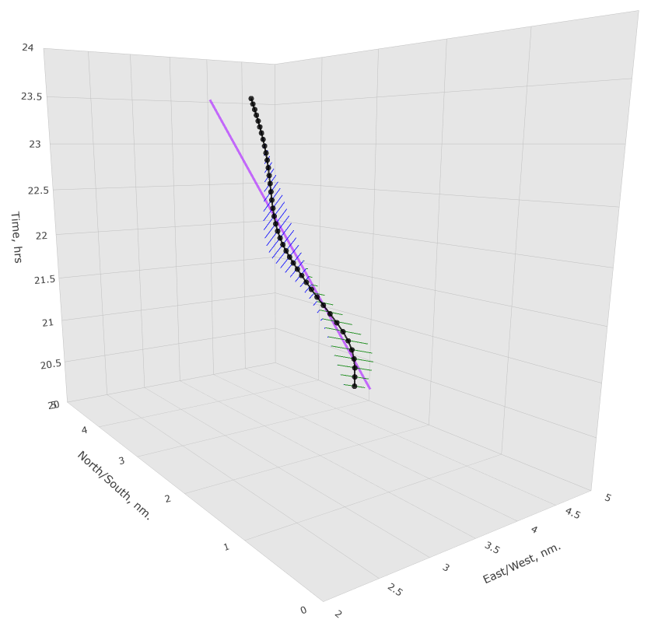
➤ BACKGROUND ➤ METHODOLOGY ➤ RESULTS
Results
Evolution of the examined path:
INITIAL HEURISTIC GUESS
APPLIED SHAPING PARAMETERS
SHAPED NODES ARE BLENDED TO FORM ALTERED PATH

Slide 22
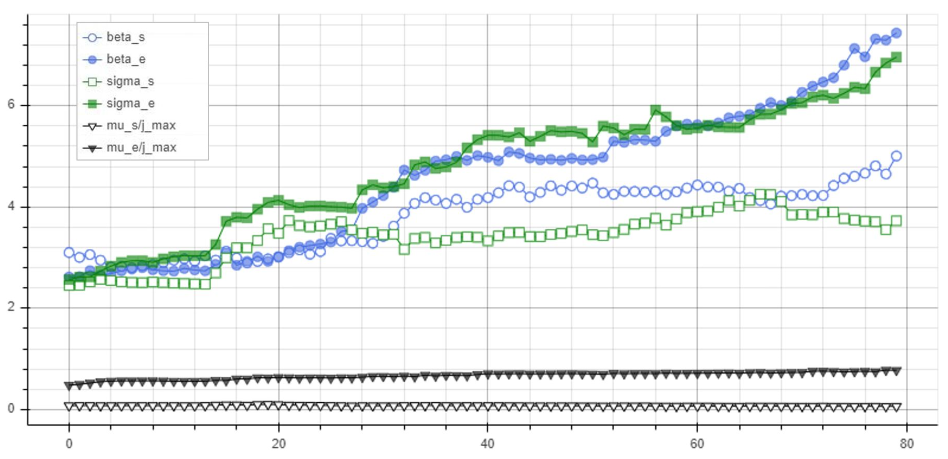
➤ BACKGROUND ➤ METHODOLOGY ➤ RESULTS
Results
Evolution of the examined path (Parameters):
Value
Generation

Slide 23
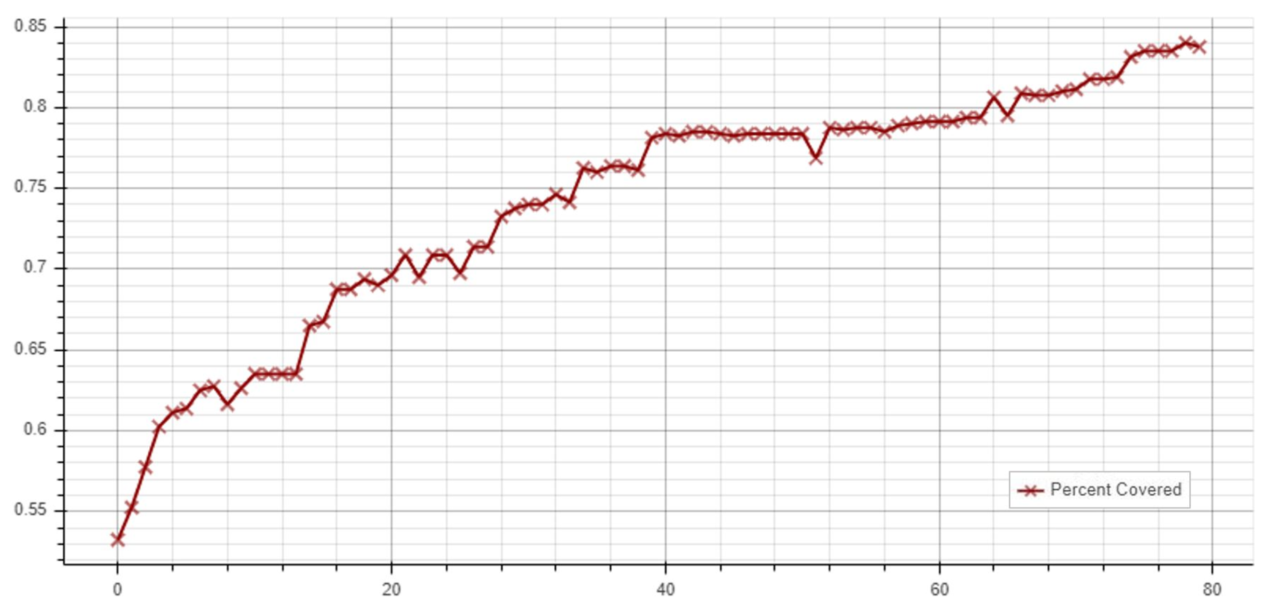
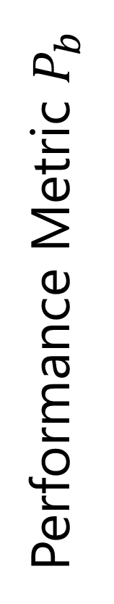
➤ BACKGROUND ➤ METHODOLOGY ➤ RESULTS
Results
Evolution of the examined path (Parameters):
Performance Metric $P_{b}$
Generation

Slide 24
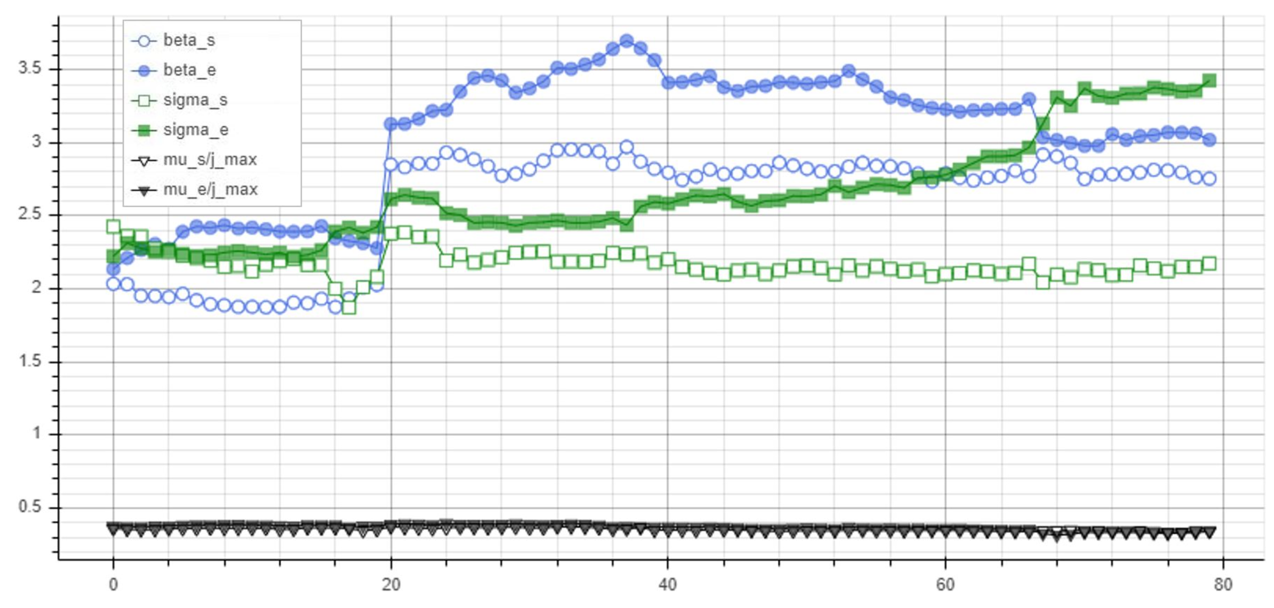
➤ BACKGROUND ➤ METHODOLOGY ➤ RESULTS
Results
Evolution of the examined path (Parameters):
Value
Generation

Slide 25
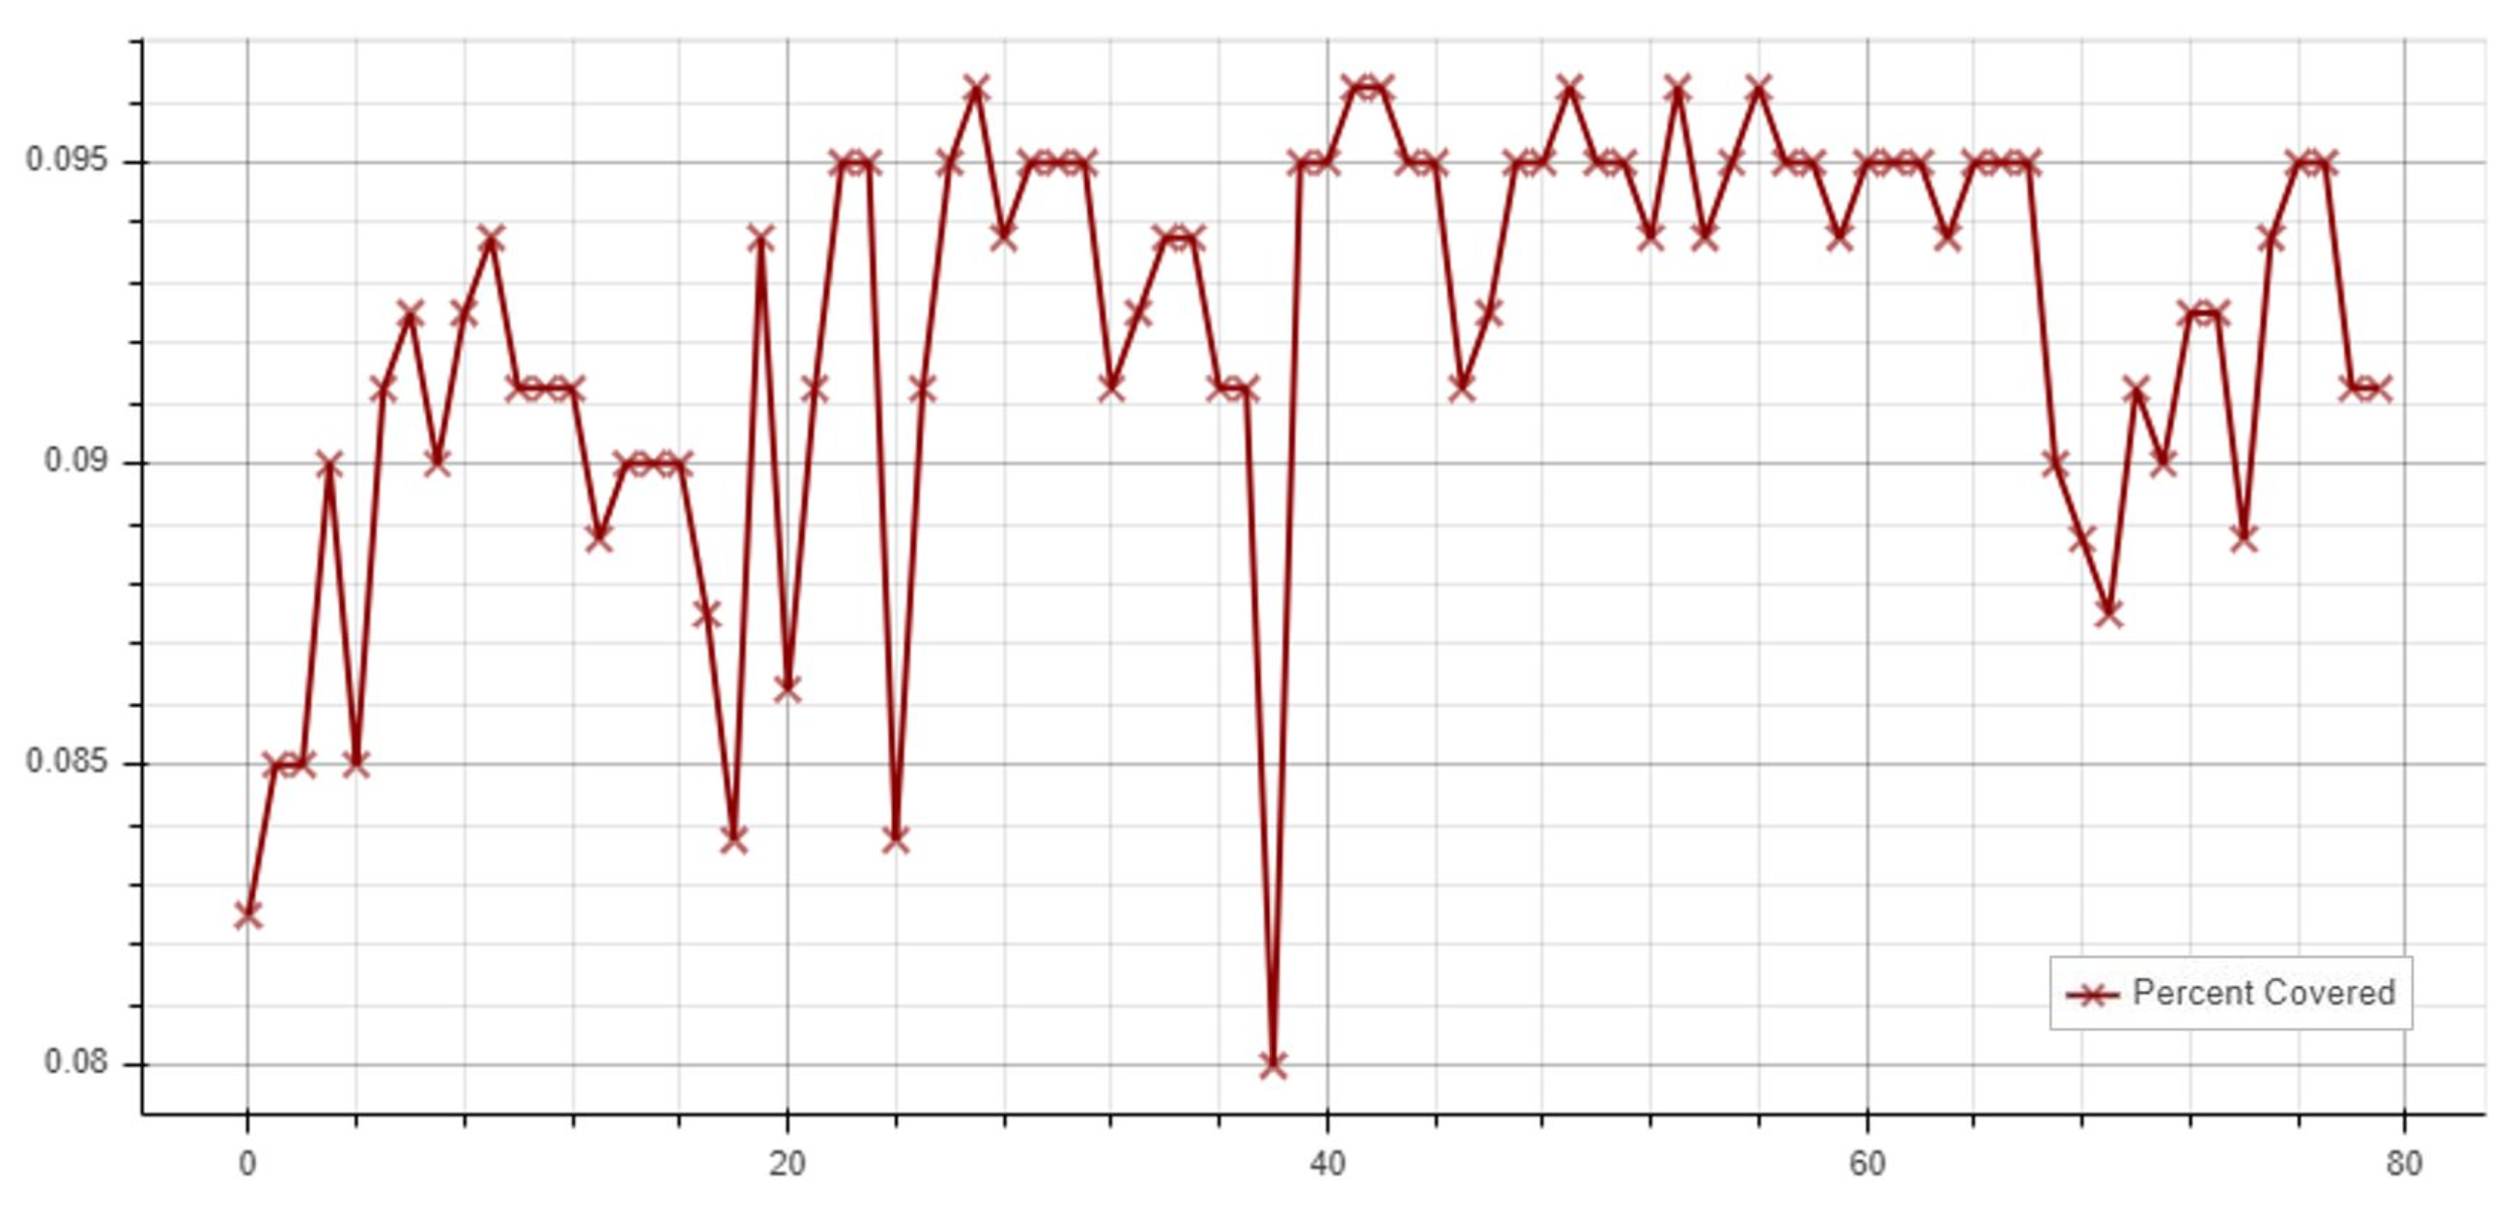
➤ BACKGROUND ➤ METHODOLOGY ➤ RESULTS
Results
Evolution of the examined path (Parameters):
Performance Metric $P_{b}$
Generation

Slide 26
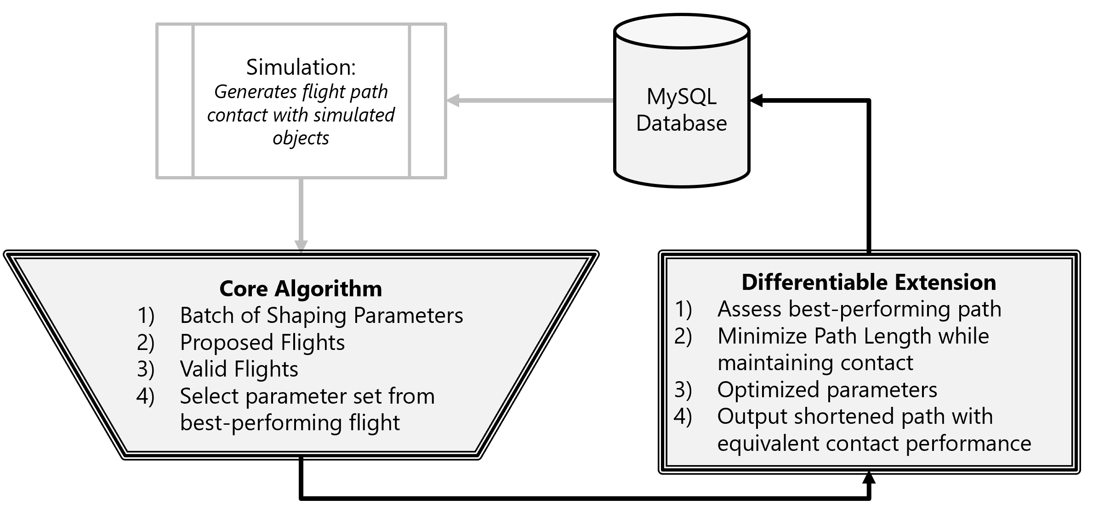
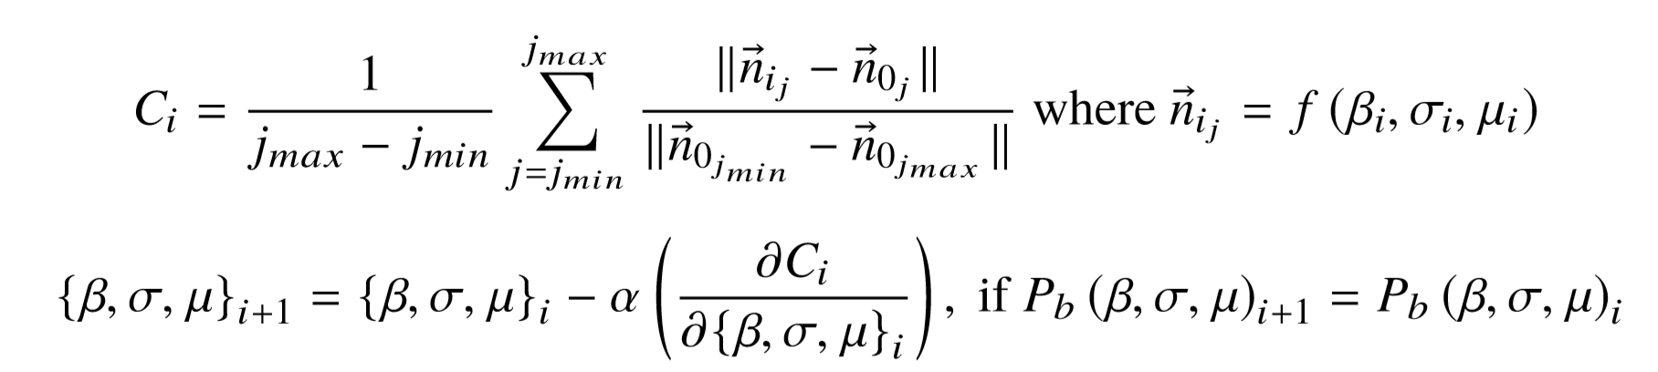
➤ BACKGROUND ➤ METHODOLOGY ➤ RESULTS
Future Work
Append a block calculating a differentiable cost function for the route deviation which maintains equivalent contact with object (constant $P_{b}$)
Minimize the new cost function using the final $\left\{β, σ, μ\right\}$ parameters with gradient descent methods
AVG ALTERATION MAGNITUDE
ALTERED FLIGHT NODES ARE USED
CONSTANT CONTACT PERFORMANCE

Slide 27

➤ BACKGROUND ➤ METHODOLOGY ➤ RESULTS
Conclusion
Presented a methodology for tracking moving objects with regular schedules by means of a genetic algorithm
The parallel encounter in the east fared better, with a 13% increase in the performance metric after only 24 ﬂights
Performance Metric $P_{b}$
APPLIED SHAPING PARAMETERS
Generation

